Slide 1
Airbnb Storytelling Assignment
Ameya Kulkarni

Slide 2
Index
Objective
Background
Key Findings
Recommendations
Appendix

Slide 3
Objective
Improve our shared understanding about the market conditions
Improve shared understanding about our customers
Provide recommendation to various departments to be prepared for the changes post pandemic

Slide 4
Background
Airbnb, Inc. is an American company that operates an online marketplace for lodging, primarily homestays for vacation rentals, and tourism activities. Based in San Francisco, California, the platform is accessible via website and mobile app.
Airbnb does not own any of the listed properties; instead, it profits by receiving commission from each booking. The company was founded in 2008 by Brian Chesky, Nathan Blecharczyk, and Joe Gebbia. Airbnb is a shortened version of its original name, AirBedandBreakfast.com.

Slide 5
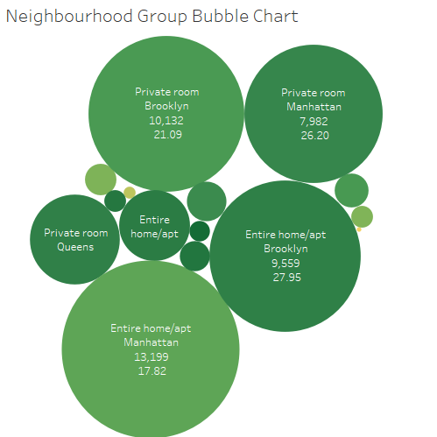
Neighbourhood Wise Business Distribution
Private rooms are the most popular throughout New York >25 reviews per listing
Entire home/apt in Manhattan has reviews per listing 35% less than the average of 27.7
Except Manhattan, all areas performed poorly in shared rooms with an average of 7.3 reviews per listing

Slide 6
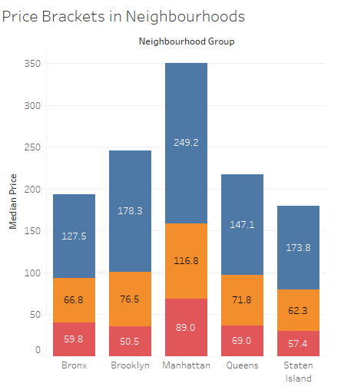
Pricing in Preferred Locations
Entire home/apt’s price is ~100% more than private rooms except Brooklyn and Staten Island with ~150%.
Private room’s price is ~10% more than shared rooms except Brooklyn and Manhattan with ~40%.
Manhattan is costliest overall and the cheapest are: o Entire apt: Bronx o Private room: Staten Islands o Shared room: Brooklyn.

Slide 7
Recommendations
Acquire private rooms and entire apartments, especially in Staten Islands since it is popular
Reducing the prices of entire apartments in Manhattan by at least 15% and increasing the price of private rooms in Queens by at least 10%
Listings most popular have minimum number of nights requirement from 1-5 days and 30 days which should be showcased the most ordering them by properties which are available for most number of days to least

Slide 8
Appendix: Data Attributes
Here is a snapshot of the data:
Host listing information like host name, neighborhood, latitude and longitude
Customer preference information like number of reviews and number of reviews per month

Slide 9
Appendix: Data Methodology
Used Tableau to visualize correctly to get insights
Since outliers existed in price field, used median of price instead of mean for analysis purposes

Slide 10
Appendix: Data Assumptions
Used Reviews per Listing as the popularity measure to gain information on customer preferences.
Number of reviews assumed to be a base measure to find customer preferences.
Null values assumed to have no material impact on analysis.

